Slide 1
Meso Level: Cliques, Groups and Communities

Slide 2
Levels of Analysis
Micro: vertex, dyad, triad
  local processes
Macro: whole network
  emergent, global
Meso: groups, organizations, subgraphs, motifs

Slide 3
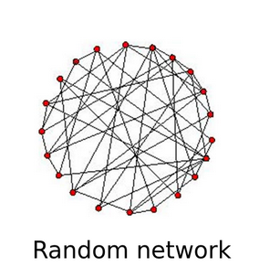
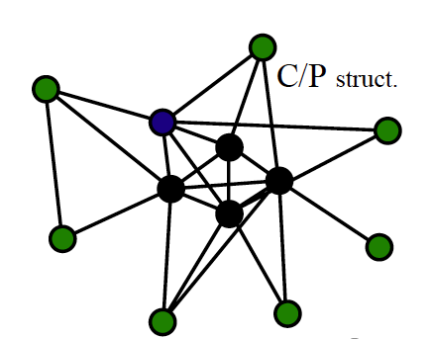
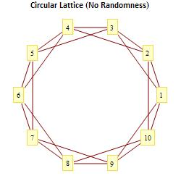
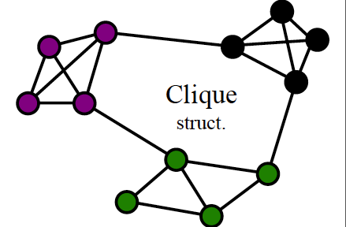
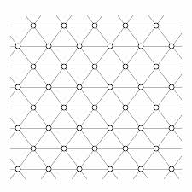
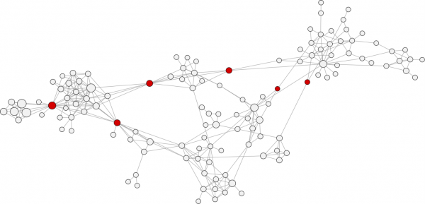
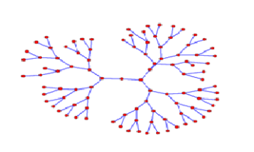
Meso Level Structures
group, community, cluster, cliques
core-periphery structure
overlapping circles structure
Hierarchy (trees)
Strings
Lattices
Note TRIANGLES

Slide 4
Three approaches
Cliques
Cohesive Groups
Communities (Clusters)

Slide 5
Clique
A subset of N vertices with a density of 1
  All ties among all vertices
  Within group vertices have equal degree
  Triangle is a clique: a 3-clique
  Can have 4-cliques, 5- cliques, 6-cliques ????
But what if 1 tie missing?
  Is set no longer a clique?
  Allow some missing edges (density/degree threshold)
    N-cliques: 2-clique, everyone can reach every other member of the clique is 2 hops or less
    k-plexes: everyone has g-k neighbors ( g-1 is a clique)
    K-Cores: everyone has at least k neighbors

Slide 6
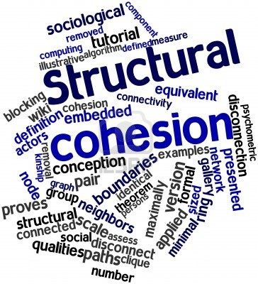
Cohesion
Theoretical concept: Social Solidarity
  However, concept riddle with (operational) ambiguity.
  Network science to the rescue!
Two components:
  Ideational (identification)
  Relational (connectivity)
Network theory is useful for specifying relational solidarity (structural cohesion)

Slide 7
Cohesion
Key theoretical insight:
  Cohesion implies nested groups
Operational definition
  A group is more cohesive to the extent to that it depends on a majority of its members to retain its character as a group
  Less cohesive groups depend on a few individuals (at the limit one) to remain connected
Structural cohesion is simultaneously a property of
  Persons
  Groups

Slide 8
Cohesion
Definition 1: A collectivity is structurally cohesive to the extent that the social relations of its members hold it together.
  Describes how a collection of actors is
  held together
  Group-level property
  Continuous concept (some groups are more or less cohesive)
  Depends on relational data
  Independent of size

Slide 9
Cohesion
Unconnected individuals are not cohesive
Cohesive individuals must be connected by some path
The most cohesive groups connect individuals via multiple paths
The more cohesive the group, the more redundant paths we can trace between any two individuals

Slide 10
Cliques and Cohesion
Definition 2: A group is structurally cohesive to the extent that multiple independent relational paths among all pairs of members hold it together.
  A group is cohesive to the extent that its connectivity is robust to the removal of any single individual

Slide 11
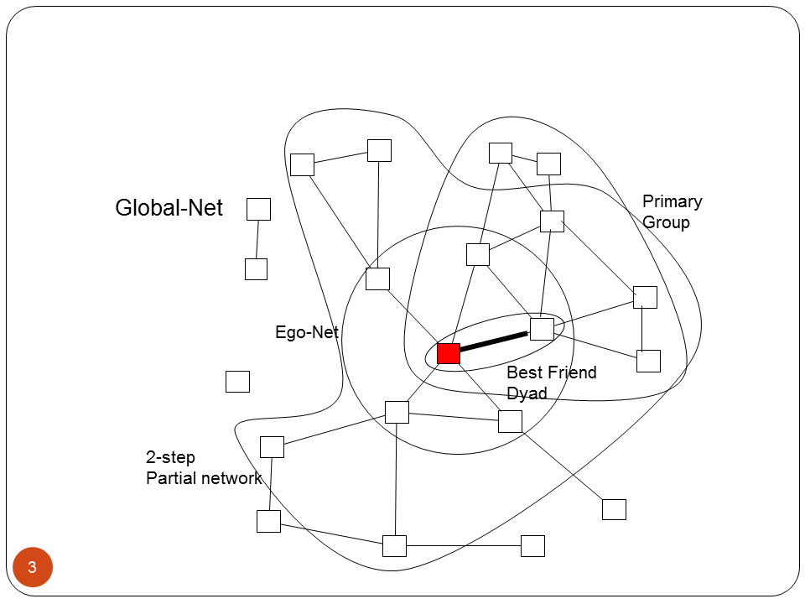
Graph Theory: Connectivity
A graph is connected if there exists a (finite) path between each vertex
  Otherwise the graph is disconnected
A maximal connected subgraph is called a component
  In a graph, the connected subgraph that contains the largest proportion of vertices is called the giant component

Slide 12
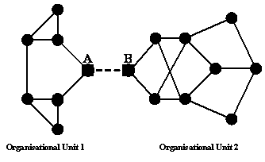
Graph Theory: Cutpoints and Cutsets
A cutpoint is a vertex v that would disconnect the graph upon removal
  A block is subgraph G' that contains no cutpoints
A cutset is a set of vertices {v₁, v,₂,...v_{n}} that would disconnect the graph upon removal
  A minimal cutset is the smallest number of vertices n whose removal would disconnect the graph

Slide 13
Graph Theory: K-connectivity
A graph with a minimal cutset of size k, is said to be k-connected
The k-connectivity of any two vertices {u, v} in graph G, is the number of vertices that must be removed to disconnect u and v
  Thus, if it takes removing three nodes to disconnect two vertices, u and v are said to be three-connected.

Slide 14
Graph Theory: Edge-connectivity
A bridge is an edge uv in graph G whose removal would disconnect the graph
The edgecut is the set of edges E' whose removal would disconnect the graph
  The edgecut for a pair of vertices u, v is defined in the same way
  The miminal edgecut is the smallest number of edges m whose removal would disconnect the graph
  The edge connectivity of a graph is the size of the minimal edgecut

Slide 15
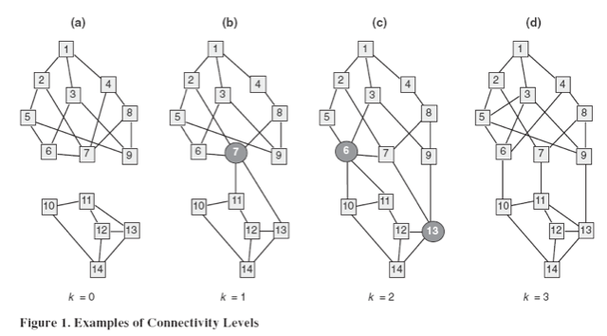
Group Cohesion
Definition 3a: A group’s structural cohesion is equal to the minimum number of actors who, if removed from the group, would disconnect the group
Definition 3b: A group’s structural cohesion is equal to the minimum number of independent paths linking each pair of actors in the group.

Slide 16

Cohesive Blocking
Identify the k-connectivity of the input graph
Remove the k-cutset (vertices)
Do the same on the resulting subgraphs until no more subdivisions can be obtained

Slide 17
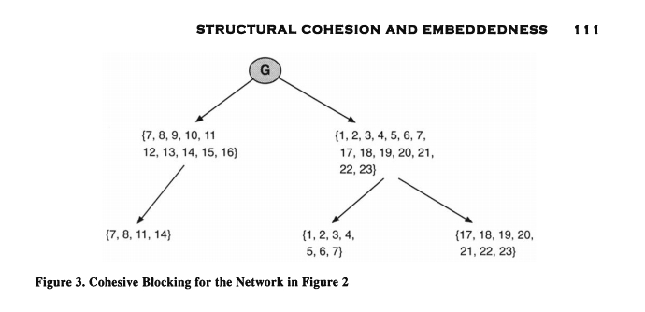
Cohesive Blocking

Slide 18
Cohesive Blocking
Vertices may belong to multiple cohesive subgroups
Such vertices are positionally equivalent with respect to the subgroups that they connect

Slide 19
Communities
Like islands with bridges between
Few edges between clusters, many edges within clusters
Dense areas and sparse areas

Slide 20
Community Detection
Vertex trait: Within cluster trait homophily
  population homogeneity
  ideational solidarity
Edge connectivity
  Few edges between clusters, many edges within clusters

Slide 21
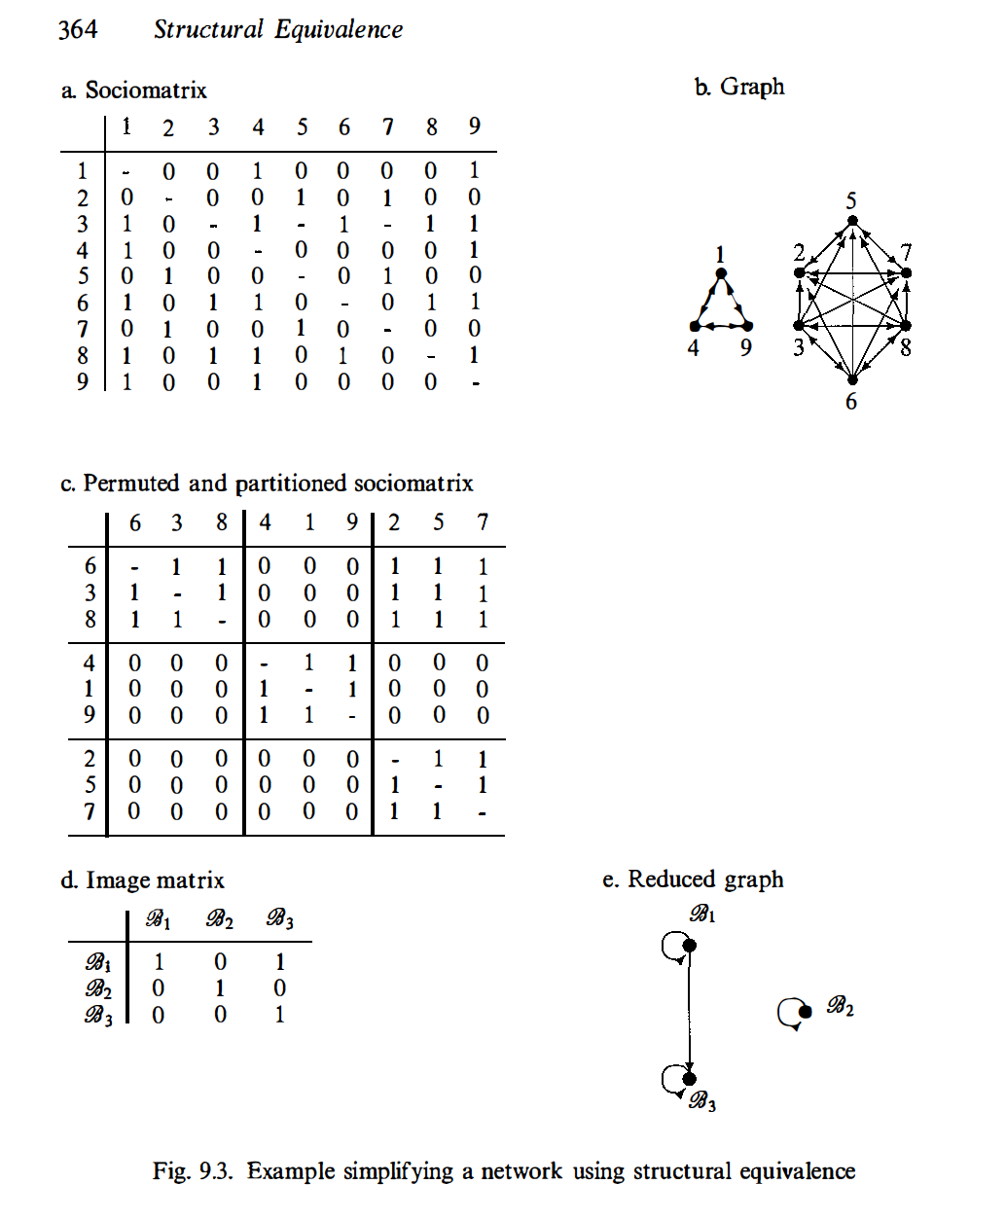
Block Model:
Communities
Permute the matrix by rearranging rows and columns
Partition into high (all 1s) and low (all 0s) density blocks
Communities fall along the main diagonal

Slide 22
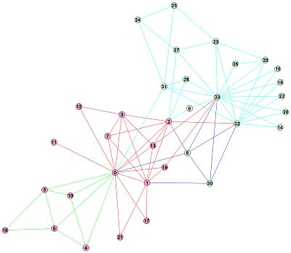
Detecting Communities in networks
Basic task:
  To discover groups or clusters in networks, usually referred to as communities
  A community is densely connected set of vertices with sparse connections with other groups
Edge Connectivity: Few edges between clusters, most edges within clusters
These are referred to as community detection methods

Slide 23
Algorithms
Minimize between cluster edges, maximize within cluster edges
Girvan-Newman: edge betweenness
Clauset-Newman-Moore: modularity

Slide 24
Edge Betweenness
Edge betweenness is like betweenness centrality for vertices
Number (or proportion) of geodisics that an edge is on
Remove edges beginning with edge with highest edge betweenness until desired number of groups (communities) is reached

Slide 25
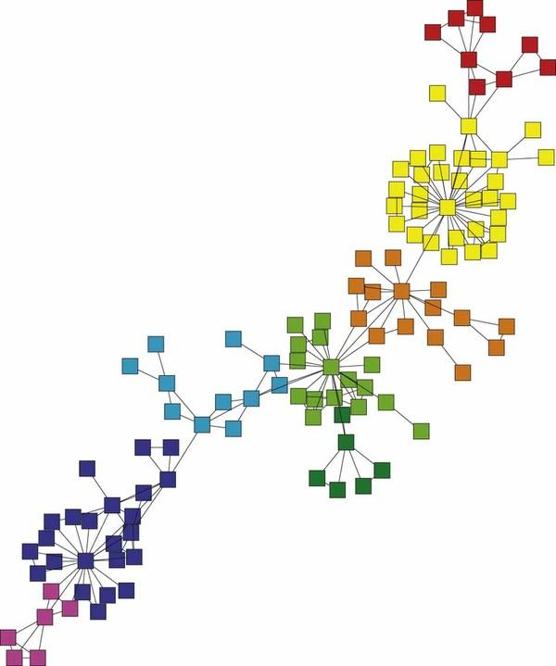
Modularity and Community Detection
The basic idea is that a network has "community structure" if the edges are arranged in a "statistically surprising" way
  A quantity known as the modularity can be used for this purpose

Slide 26
Modularity and Community Detection
In words, for a partition of the graph into C groups, the modularity is defined as:
  The observed number of edges falling within groups minus the expected number of edges in the same network if these were placed at random
    Configuration Model
  Positive values indicate the presence of community structure

Slide 27


Modularity and Community Detection
In a network the observed number of edges between vertices i and j is given by the corresponding entry in the adjacency matrix Aij (usually 0 or 1)
The expected number of edges between i and j is simply a function of their respective degrees:

Slide 28


Modularity and Community Detection
The modularity (Q) is then given by the sum of the difference between observed minus expected across each pair of vertices that belong to the same group:
Where s_{i}= 1 if vertex i belongs to group 1 and s_{i}= -1 if vertex belongs to group 2
The matrix containing observed minus expected differences for each pair of vertices is known as the modularity matrix:

Slide 29
Modularity and Community Detection
Newman (2006) proposes an algorithm for partitioning a network into two communities based on the B matrix:
  Compute the leading eigenvector of the modularity matrix
    For a matrix the leading eigenvector is the one associated with the largest (most positive) eigenvalue following a factorization of the matrix
  Assign vertices into two disjoint groups based on the sign of the corresponding element in the vector
    Vertices with positive values go in one group
    Vertices with negative values go into the other group
  Compute modularity Q
  Repeat for each group and computer modularity Q to see if there is a change in modularity as a result of the next division

Slide 30
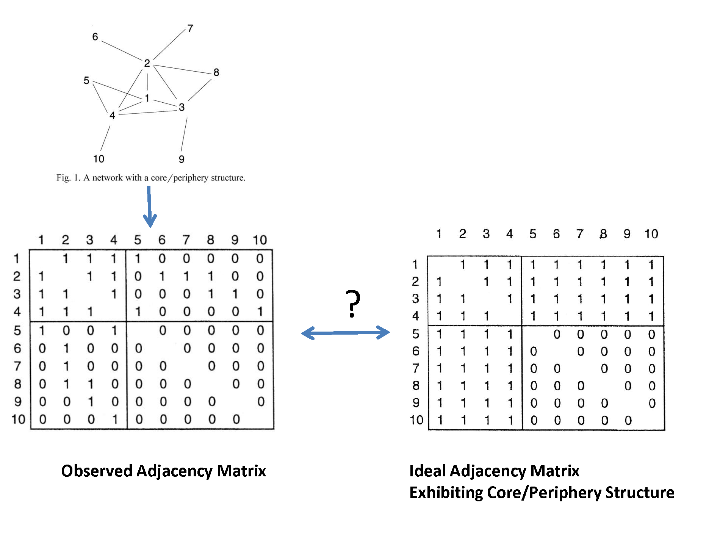
Core-Periphery Structure

